Slide 1

Evaluating interfaces with users
Why evaluation is crucial
Quickly debug prototypes by observing people use them
Methods reveal what a person is thinking about
Ethics
Slide deck by P.Viswanathan. Permission is granted to use this for non-commercial purposes as long as general credit to P.Viswanathan is clearly maintained.
Warning: some material in this deck is used from other sources without permission. Credit to the original source is given if it is known.

Slide 2
Canon
Fax-B320
Bubble Jet Facsimile
SHQ
ON LINE
HS
HQ
PRINTER
INTERFACE
PRINTER ERROR
PRINT MODE
PRINTER
<
>
1
2
3
CODED DIAL
/DIRECTORY
V
^
memory
trans
delayed
trans
delayed
polling
polling
01
02
03
04
4
5
6
confd
trans
relay
broadca
report
R
HOLD
05
06
07
08
7
8
9
+
D.T.
Tone
Pause
09
10
11
12
*
0
#
space
clear
13
14
15
16

Slide 3
Why bother?
Tied to the usability engineering lifecycle
Pre-design
  investing in new expensive system requires proof of viability
Initial design stages
  develop and evaluate initial design ideas with the user
design
evaluation
implementation

Slide 4
Why bother?
Iterative design
  does system behavior match the user’s task requirements?
  are there specific problems with the design?
  what solutions work?
Acceptance testing
  verify that system meets expected user performance criteria
    80% of 1st time customers will take 1-3 minutes to
    withdraw $50 from the automatic teller
design
evaluation
implementation

Slide 5

Naturalistic approach
Observation occurs in realistic setting
  real life
Problems
  hard to arrange and do
  time consuming
  may not generalize

Slide 6
Experimental approach
Experimenter controls all environmental factors
  study relations by manipulating independent variables
  observe effect on one or more dependent variables
  Nothing else changes
  There is no difference in user performance (time and error rate) when selecting an item from a pull down or a pull right menu of 4 items
File Edit View Insert
File
New
New
Edit
Open
Open
View
Close
Close
Insert
Save
Save

Slide 7
Validity
External validity
  confidence that results applies to real situations
  usually good in natural settings
Internal validity
  confidence in our explanation of experimental results
  usually good in experimental settings
Trade-off: Natural vs Experimental
  precision and direct control over experimental design versus
  desire for maximum generalizability in real life situations

Slide 8
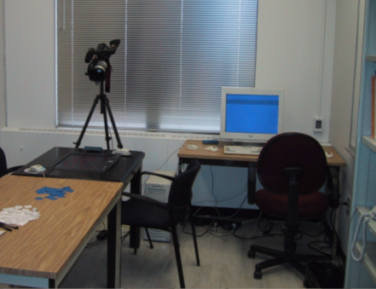
Usability engineering approach
Observe people using systems in simulated settings
  people brought in to artificial setting that simulates aspects of real world setting
  people given specific tasks to do
  observations / measures made as people do their tasks
  look for problem areas / successes
  good for uncovering ‘big effects’

Slide 9
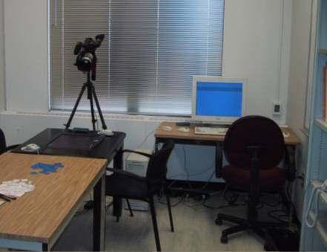
Usability engineering approach
Is the test result relevant to the usability of real products in real use outside of lab?
Problems
  non-typical users tested
  non-typical tasks
  different physical environment
  different social context
    motivation towards experimenter vs
    motivation towards boss
Partial Solution
  use real users
  task-centered system design tasks
  environment similar to real situation

Slide 10
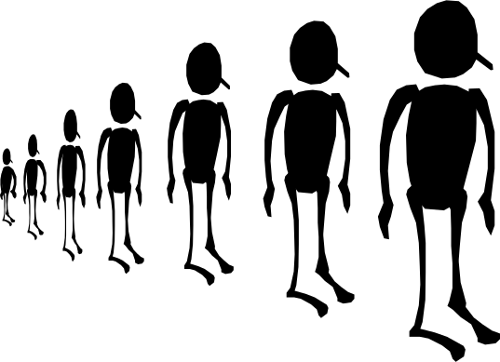
Usability engineering approach
How many users should you observe?
  observing many users is expensive
  but individual differences matter
    best user 10x faster than slowest
    best 25% of users ~2x faster than slowest 25%
partial solution
  reasonable number of users tested
  reasonable range of users
  big problems usually detected with handful of users
  small problems / fine measures need many users

Slide 11
Discount usability evaluation
Low cost methods to gather usability problems
  approximate: capture most large and many minor problems
How?
  qualitative:
    observe user interactions
    gather user explanations and opinions
    produces a description, usually in non-numeric terms
    anecdotes, transcripts, problem areas, critical incidents…
  quantitative
    count, log, measure something of interest in user actions
    speed, error rate, counts of activities,

Slide 12
Discount usability evaluation
Methods
  inspection
  extracting the conceptual model
  direct observation
    think-aloud
    constructive interaction
  query techniques (interviews and questionnaires)
  continuous evaluation (user feedback and field studies)

Slide 13

Inspection
Designer tries the system (or prototype)
  does the system “feel right”?
  benefits
    can catch some major problems in early versions
  problems
    not reliable as completely subjective
    not valid as introspector is a non-typical user
    intuitions and introspection are often wrong
Inspection methods help
  task centered walkthroughs
  heuristic evaluation

Slide 14
Conceptual model extraction
How?
  show the user static images of
    the prototype or screens during use
  ask the user explain
    the function of each screen element
    how they would perform a particular task
What?
  Initial conceptual model
    how person perceives a screen the very first time it is viewed
  Formative conceptual model
    How person perceives a screen after its been used for a while
Value?
  good for eliciting people’s understanding before & after use
  poor for examining system exploration and learning

Slide 15
Direct observations
Evaluator observes users interacting with system
  in lab:
    user asked to complete a set of pre-determined tasks
  in field:
    user goes through normal duties
Value
  excellent at identifying gross design/interface problems
  validity depends on how controlled/contrived the situation is

Slide 16

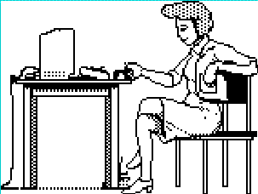
Simple observation method
User is given the task
Evaluator just watches the user
Problem
  does not give insight into the user’s decision process or attitude

Slide 17
Think aloud method
Users speak their thoughts while doing the task
  what they are trying to do
  why they took an action
  how they interpret what the system did
  gives insight into what the user is thinking
  most widely used evaluation method in industry
    may alter the way users do the task
    unnatural (awkward and uncomfortable)
    hard to talk if they are concentrating
Hmm, what does this do? I’ll try it… Ooops, now what happened?

Slide 18
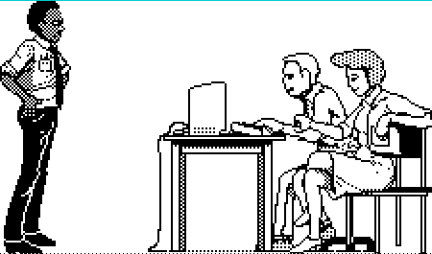
Constructive interaction method
Two people work together on a task
  monitor their normal conversations
  removes awkwardness of think-aloud
Co-discovery learning
  use semi-knowledgeable “coach” and novice
  only novice uses the interface
    novice ask questions
    coach responds
  gives insights into two user groups
Oh, I think you clicked on the wrong icon
Now, why did it do that?

Slide 19
Recording observations
How do we record user actions for later analysis?
  otherwise risk forgetting, missing, or misinterpreting events
  paper and pencil
    primitive but cheap
    observer records events, comments, and interpretations
    hard to get detail (writing is slow)
    2nd observer helps…
  audio recording
    good for recording think aloud talk
    hard to tie into on-screen user actions
  video recording
    can see and hear what a user is doing
    one camera for screen, rear view mirror useful…
    initially intrusive

Slide 20
Coding sheet example...
tracking a person’s use of an editor
General actions
Graph editing
Errors
text scrolling image new delete modify correct miss
editing editing node node node error error
Time
09:00
x
x
09:02
x
09:05
x
09:10
09:13

Slide 21

Interviews
Good for pursuing specific issues
  vary questions to suit the context
  probe more deeply on interesting issues as they arise
  good for exploratory studies via open-ended questioning
  often leads to specific constructive suggestions
Problems:
  accounts are subjective
  time consuming
  evaluator can easily bias the interview
  prone to rationalization of events/thoughts by user
    user’s reconstruction may be wrong

Slide 22
How to Interview
Plan a set of central questions
  a few good questions gets things started
    avoid leading questions
  focuses the interview
  could be based on results of user observations
Let user responses lead follow-up questions
  follow interesting leads vs bulldozing through question list

Slide 23
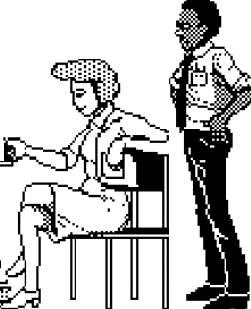

Retrospective testing interviews
Post-observation interview to
  perform an observational test
  create a video record of it
  have users view the video and comment on what they did
    clarify events that occurred during system use
    excellent for grounding a post-test interview
    avoids erroneous reconstruction
    users often offer concrete suggestions
Do you know why you never tried that option?
I didn’t see it. Why don’t you make it look like a button?

Slide 24
Critical incidence interviews
People talk about incidents that stood out
  usually discuss extremely annoying problems with fervor
  not representative, but important to them
  often raises issues not seen in lab tests
Tell me about the last big problem you had with Word
I can never get my figures in the right place. Its really annoying. I spent hours on it and I had to…

Slide 25

Questionnaires and Surveys
Questionnaires / Surveys
  preparation “expensive,” but administration cheap
    can reach a wide subject group (e.g. mail)
  does not require presence of evaluator
  results can be quantified
But
  only as good as the questions asked

Slide 26
Questionnaires and Surveys
How
  establish the purpose of the questionnaire
    what information is sought?
    how would you analyze the results?
    what would you do with your analysis?
  do not ask questions whose answers you will not use!
  determine the audience you want to reach
  determine how would you will deliver / collect the questionnaire
    on-line for computer users
    web site with forms
    surface mail
      pre-addressed reply envelope gives far better response

Slide 27
Styles of Questions
Open-ended questions
  asks for unprompted opinions
  good for general subjective information
    but difficult to analyze rigorously
  Can you suggest any improvements to the interfaces?

Slide 28
Styles of Questions
Closed questions
  restrict respondent’s responses by supplying alternative answers
  makes questionnaires a chore for respondent to fill in
  can be easily analyzed
  watch out for hard to interpret responses!
    alternative answers should be very specific
  Do you use computers at work:
  O often O sometimes O rarely
  vs
  In your typical work day, do you use computers:
  O over 4 hrs a day
  O between 2 and 4 hrs daily
  O between 1and 2 hrs daily
  O less than 1 hr a day

Slide 29
Styles of Questions
Scalar
  ask user to judge a specific statement on a numeric scale
  scale usually corresponds with agreement or disagreement with a statement
  Characters on the computer screen are:
      hard to read easy to read
      1 2 3 4 5

Slide 30
Styles of Questions
Multi-choice
  respondent offered a choice of explicit responses
  How do you most often get help with the system? (tick one)
  O on-line manual
  O paper manual
  O ask a colleague
  Which types of software have you used? (tick all that apply)
  O word processor
  O data base
  O spreadsheet
  O compiler

Slide 31
Styles of Questions
Ranked
  respondent places an ordering on items in a list
  useful to indicate a user’s preferences
  forced choice
  Rank the usefulness of these methods of issuing a command
  (1 most useful, 2 next most useful..., 0 if not used
  __2__ command line
  __1__ menu selection
  __3__ control key accelerator

Slide 32
Styles of Questions
Combining open-ended and closed questions
  gets specific response, but allows room for user’s opinion
  It is easy to recover from mistakes:
    disagree agree comment: the undo facility is really helpful
    1 2 3 4 5

Slide 33
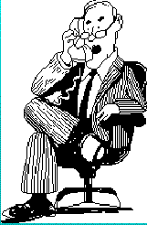
Continuous Evaluation
Monitor systems in actual use
  usually late stages of development
    ie beta releases, delivered system
  fix problems in next release
User feedback via gripe lines
  users can provide feedback to designers while using the system
    help desks
    bulletin boards
    email
    built-in gripe facility
  best combined with trouble-shooting facility
    users always get a response (solution?) to their gripes

Slide 34
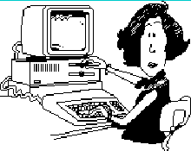
Continuous evaluation
Case/field studies
  careful study of “system usage” at the site
  good for seeing “real life” use
  external observer monitors behavior
  site visits

Slide 35
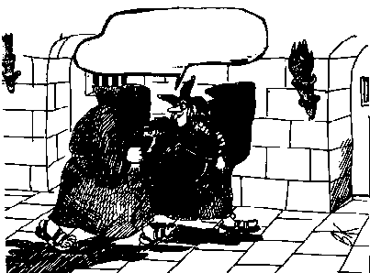
Ethics
...and to think that
you want
me to test it!!!

Slide 36
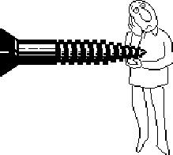
Ethics
Testing can be a distressing experience
  pressure to perform, errors inevitable
  feelings of inadequacy
  competition with other subjects
Golden rule
  subjects should always be treated with respect

Slide 37
Ethics – before the test
Don’t waste the user’s time
  use pilot tests to debug experiments, questionnaires etc
  have everything ready before the user shows up
Make users feel comfortable
  emphasize that it is the system that is being tested, not the user
  acknowledge that the software may have problems
  let users know they can stop at any time
Maintain privacy
  tell user that individual test results will be completely confidential
Inform the user
  explain any monitoring that is being used
  answer all user’s questions (but avoid bias)
Only use volunteers
  user must sign an informed consent form

Slide 38
Ethics – during the test
Don’t waste the user’s time
  never have the user perform unnecessary tasks
Make users comfortable
  try to give user an early success experience
  keep a relaxed atmosphere in the room
  coffee, breaks, etc
  hand out test tasks one at a time
  never indicate displeasure with the user’s performance
  avoid disruptions
  stop the test if it becomes too unpleasant
Maintain privacy
  do not allow the user’s management to observe the test

Slide 39
Ethics – after the test
Make the users feel comfortable
  state that the user has helped you find areas of improvement
Inform the user
  answer particular questions about the experiment that could have biased the results before
Maintain privacy
  never report results in a way that individual users can be identified
  only show videotapes outside the research group with the user’s permission

Slide 40
What you now know
Debug designs by observing how people use them
  quickly exposes successes and problems
  specific methods reveal what a person is thinking
  but naturalistic vs laboratory evaluations is a tradeoff
Methods include
  conceptual model extraction
  direct observation
    think-aloud
    constructive interaction
  query via interviews, retrospective testing and questionnaires
  continuous evaluation via user feedback and field studies
Ethics are important

Slide 41
Interface Design and Usability Engineering
Articulate:
who users are
their key tasks
Brainstorm designs
Refined designs
Completed designs
Goals:
Task centered system design
Participatory design
User-centered design
Psychology of everyday
things
User involvement
Representation & metaphors
Participatory interaction
Task scenario walk-
through
Graphical screen design
Interface guidelines
Style
guides
Evaluate
tasks
Usability testing
Heuristic evaluation
Field testing
Methods:
low fidelity prototyping methods
high fidelity prototyping methods
Products:
User and task descriptions
Throw-away paper prototypes
Testable prototypes
Alpha/beta systems or complete specification

